Slide 1


HR Analytics
RAYAN ABDULAZIZ

Slide 2
Outlines :
BackStory
Tools
1
3
2
Objects
4
Work flow
5
Conclusion

Slide 3
BackStory
MNC has 9 large broad sectors throughout the organization One problem is to identify the most superior people and the final win is announced only after the evaluation and this delays the transition to new roles and therefore the company needs to help identify the winners.

Slide 4
Objects
Which department has the most award wins?
Do age has an affect on years of experience and winning award ?
Who has the most won , females or males?

Slide 5


TOOls
Technologies
PYthon
Jupyter
Libraries
Pandas
Nunmpy
Matplotlibe
seaborn

Slide 6

work flow
2-Cleaning Data
3-Answer Questions
1-import data

Slide 7

Dataset
Get this data from KAGGLE.COM
23490 rows
10 columns

Slide 8
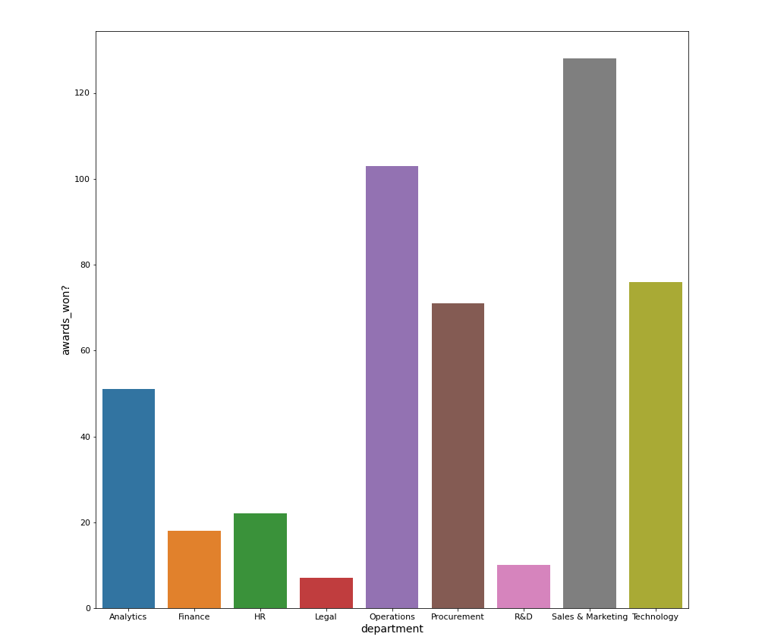
Results
Which department has the most award wins?

Slide 9
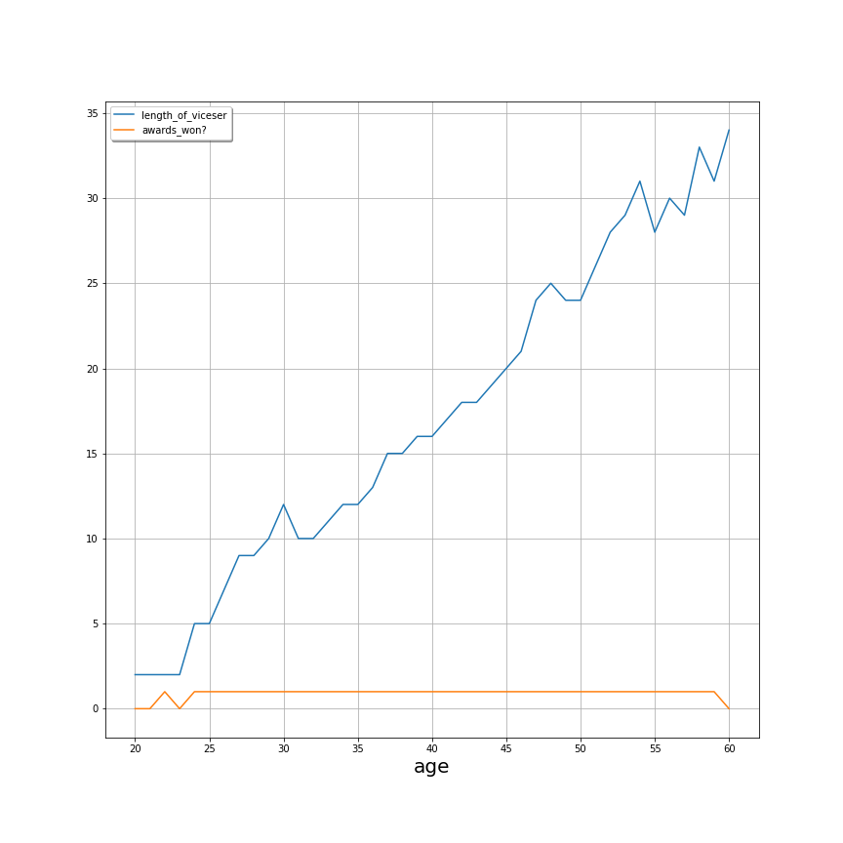
Results
Do age has an affect on years of experience and winning award ?

Slide 10
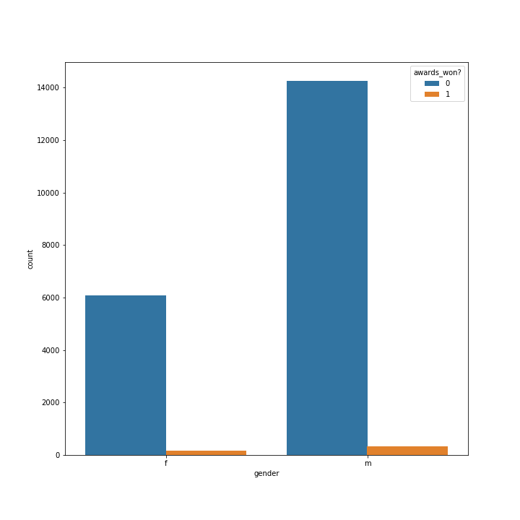
Results
Who has the most won , females or males?

Slide 11
Conclusion
In conclusion, this result will help the company identify the most superior employees.

Slide 12
THANKS

